Slide 1
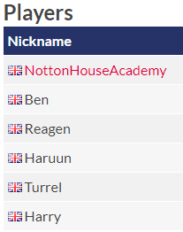

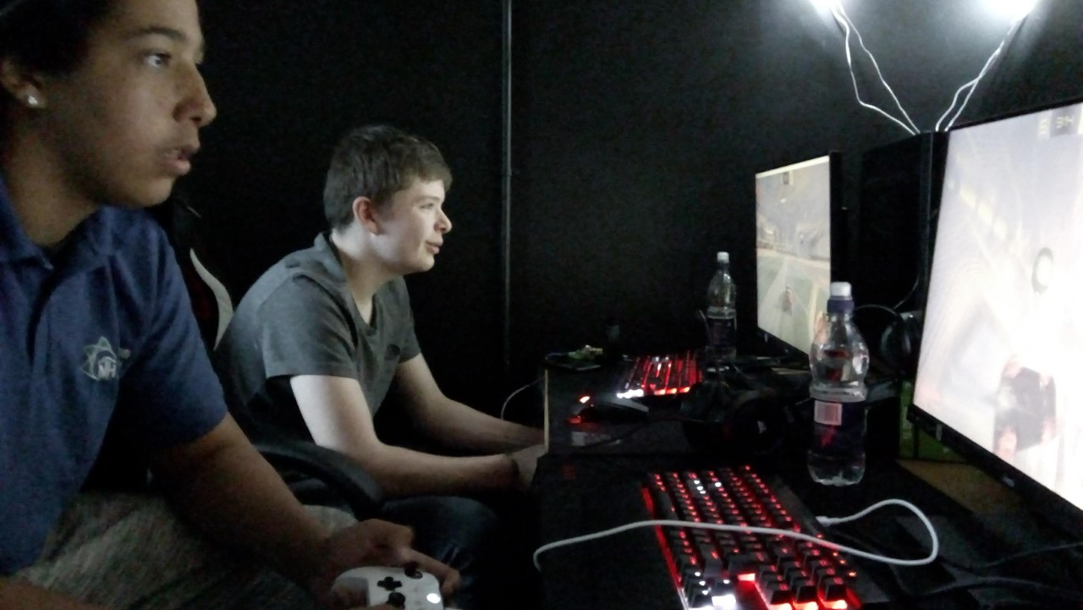
S3 Rocket League

Slide 2
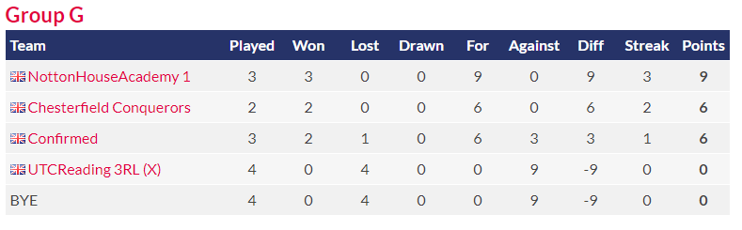
Group stage
With one game left to play, we currently sit at the top of the group. We have to win all of our matches to go through to the elimination stage.

Slide 3
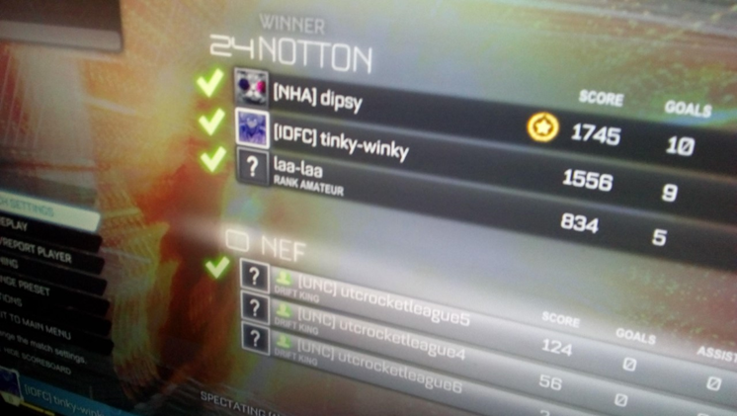
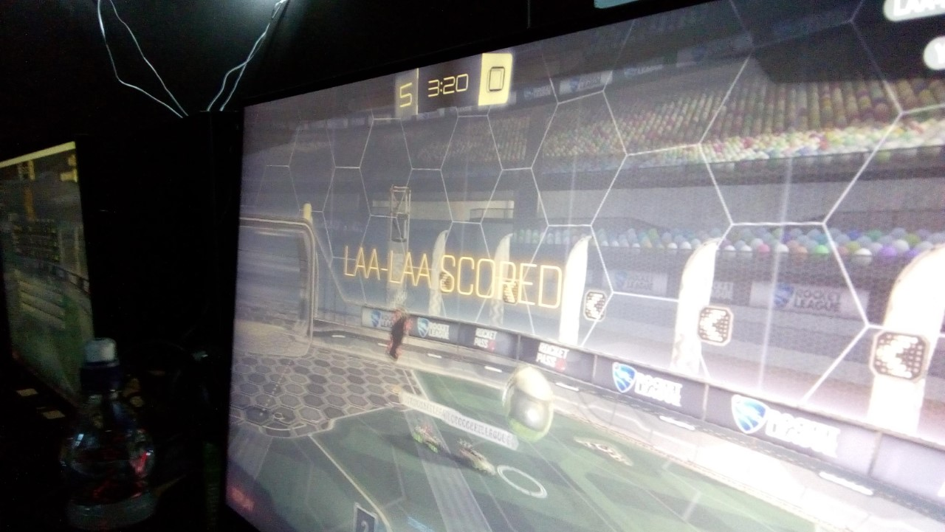
Our first game of the season results in our best win to date. 24 – 0 against North East Futures UTC.
The matches were really great fun to watch and the boys were communicating well and encouraging and supporting each other throughout the entire fixture.

Slide 4
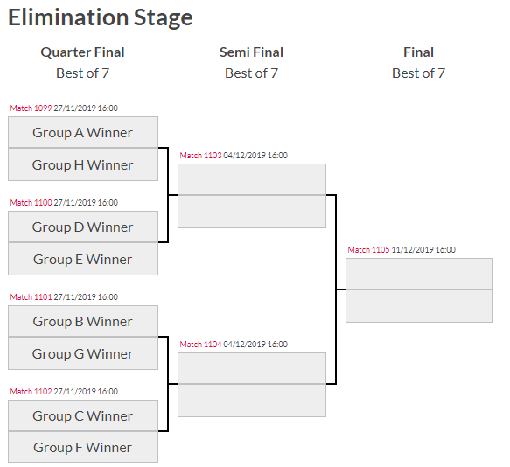
We have a final group stage game to play on Monday 18th November at 4:30pm. If we win this, then we are through to the elimination stage.

