Slide 1
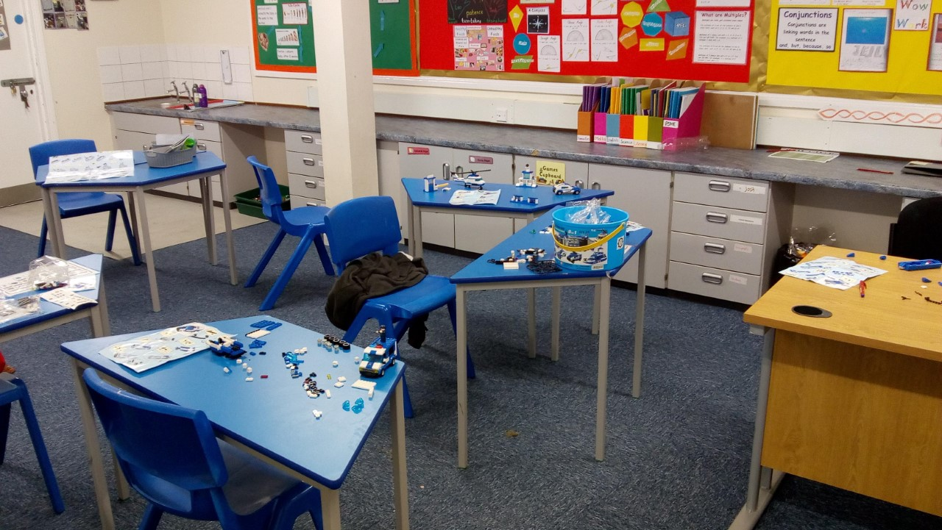
1
2
4
3
We had to do maths in Paul’s room today as I have converted the primary room into a Lego factory and have four builds running.

Slide 2
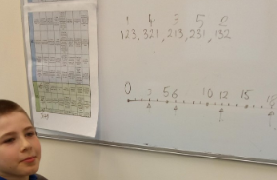
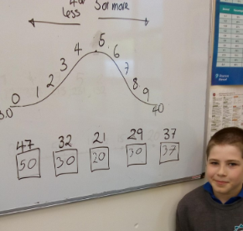
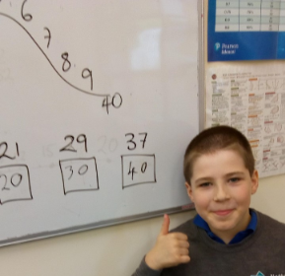
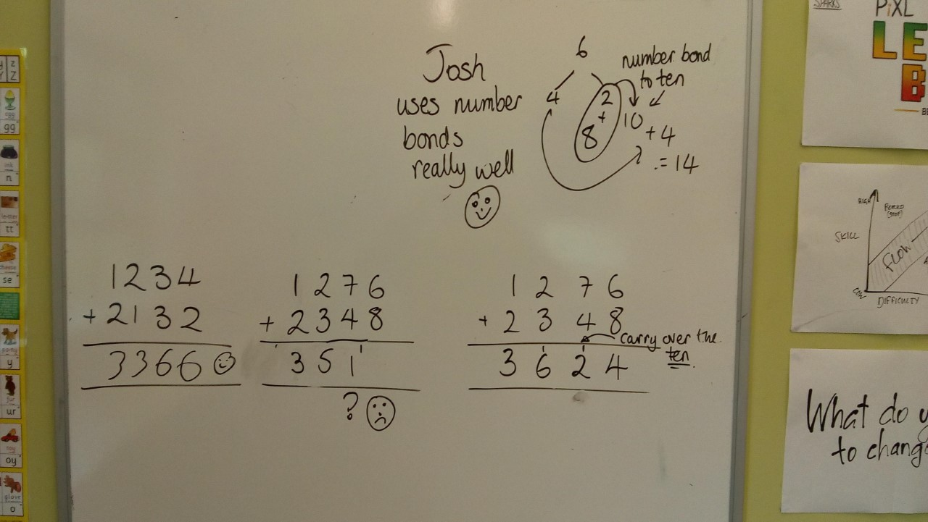
I’m also pretty good at rounding to the nearest ten and even spotted my own mistake!
I can easily order 3 digit numbers and create a number line
Paul was impressed with my use of number bonds to do fast mental addition
Tomorrow I will work on adding 3 and 4 digit numbers where I have to remember to carry over and work from right to left!
If I’m awesome I will try subtraction as well

